Slide 1
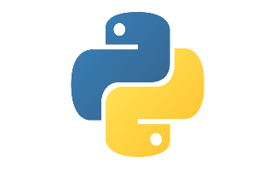
DONG-A UNIVERSITY
CPU
Python Study

Slide 2
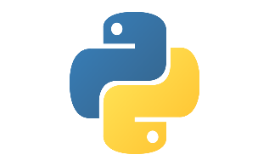
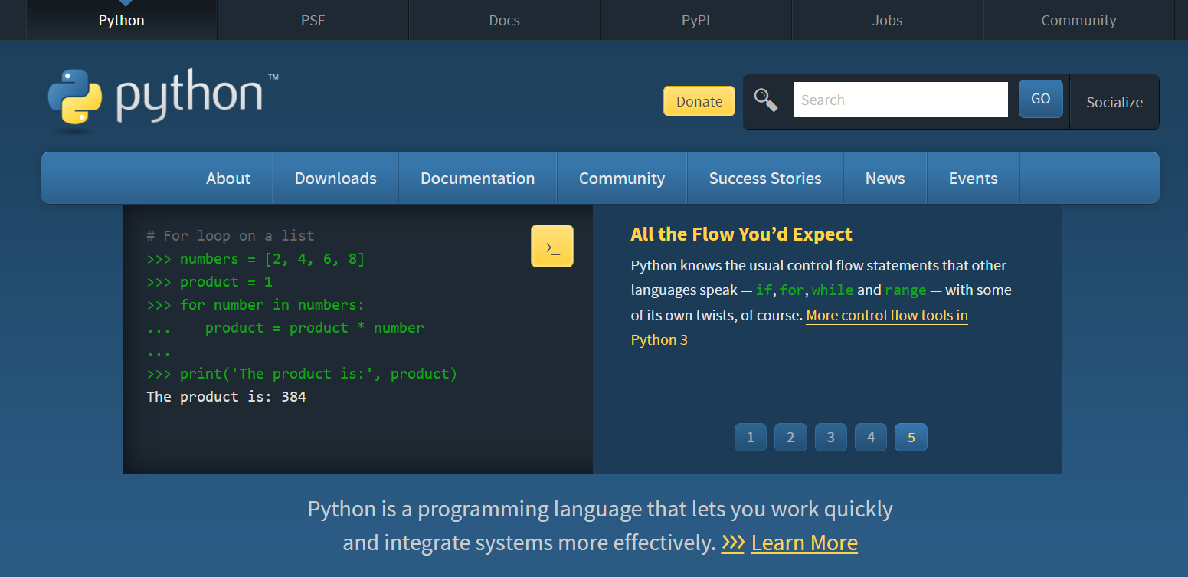
Install Python
https://www.python.org/

Slide 3
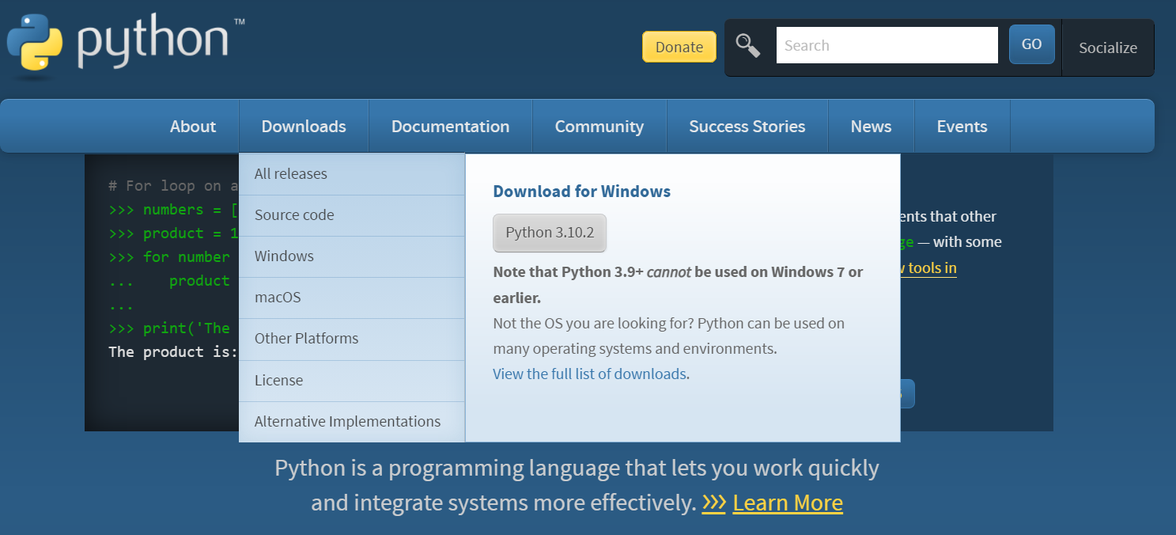
Install Python

Slide 4
Install Python

Slide 5
Install Python

Slide 6
Install Python

Slide 7
Install Python

Slide 8
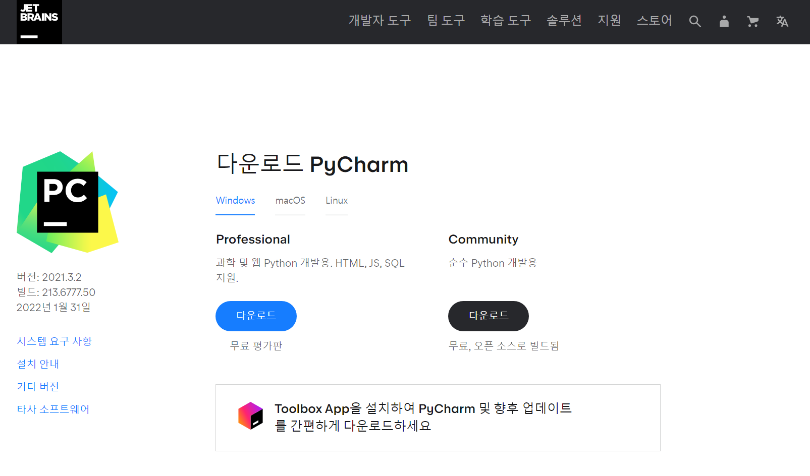
Install Python IDE - Pycharm
https://www.jetbrains.com/ko-kr/pycharm/download/#section=windows
설정 시 모두 체크를 권장
Create Desktop Shortcut : 본인 PC가 64bit면 체크
Update Path variable : 명령 프롬프트(cmd)에서 Pycharm에 접근 가능

Slide 9
Install Python IDE - Pycharm

Slide 10
Install Python IDE - Pycharm

Slide 11
Install Python IDE - Pycharm

Slide 12
Install Python IDE – VScode
Visual Studio Code - Code Editing. Redefined

Slide 13
Install Python IDE – VScode
Visual Studio Code - Code Editing. Redefined

Slide 14
Install Python IDE – VScode
Ctrl + shift + p
선택
Python 검색 후 설치

Slide 15
Install Python IDE – VScode
선택

Slide 16
Install Python IDE – VScode
선택

Slide 17
Install Python IDE – VScode
선택

